Slide 1
Lecture # 14 – Pattern Matching
Boyer-Moore & KMP

Slide 2
Overview
1. What is Pattern Matching?
2. The Brute Force Algorithm
3. The Boyer-Moore Algorithm
4. The Knuth-Morris-Pratt Algorithm
5. More Information

Slide 3
1. What is Pattern Matching?
Definition:
given a text string T and a pattern string P, find the pattern inside the text
T: “the rain in spain stays mainly on the plain”
P: “n th”
Applications:
text editors, Web search engines (e.g. Google), image analysis

Slide 4
String Concepts
Assume S is a string of size m.
A substring S[i .. j] of S is the string fragment between indexes i and j.
A prefix of S is a substring S[0 .. i]
A suffix of S is a substring S[i .. m-1]
i is any index between 0 and m-1

Slide 5
Examples
S
a
n
d
r
e
w
0
5
Substring S[1..3] == "ndr"
All possible prefixes of S:
"andrew", "andre", "andr", "and", "an”, "a"
All possible suffixes of S:
"andrew", "ndrew", "drew", "rew", "ew", "w"

Slide 6
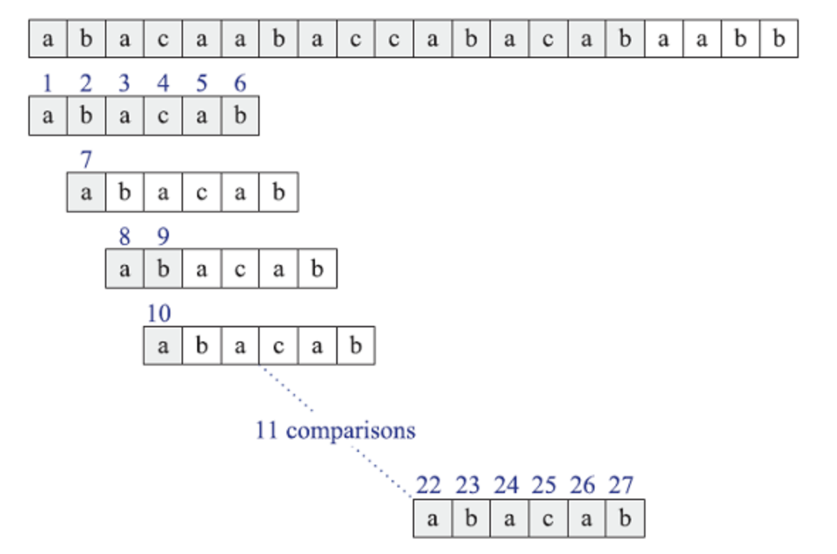
Brute-Force Matching Example
Trying every possible position for a match:

Slide 7
2. The Brute Force Algorithm
Check each position in the text T to see if the pattern P starts in that position
T:
a
n
d
r
e
w
T:
a
n
d
r
e
w
P:
r
e
w
P:
r
e
w
P moves 1 char at a time through T
. . . .

Slide 8
Brute Force in Java
Return index where
pattern starts, or -1
public static int brute(String text,String pattern) { int n = text.length(); // n is length of text int m = pattern.length(); // m is length of pattern int j; for(int i=0; i <= (n-m); i++) { j = 0; while ((j < m) && (text.charAt(i+j) == pattern.charAt(j)) ) j++; if (j == m) return i; // match at i } return -1; // no match } // end of brute()

Slide 9
Usage
public static void main(String args[]) { if (args.length != 2) { System.out.println("Usage: java BruteSearch <text> <pattern>"); System.exit(0); } System.out.println("Text: " + args[0]); System.out.println("Pattern: " + args[1]); int posn = brute(args[0], args[1]); if (posn == -1) System.out.println("Pattern not found"); else System.out.println("Pattern starts at posn " + posn); }

Slide 10
Analysis
Brute force pattern matching runs in time O(mn) in the worst case.
But most searches of ordinary text take O(m+n), which is very quick.
continued

Slide 11
The brute force algorithm is fast when the alphabet of the text is large
e.g. A..Z, a..z, 1..9, etc.
It is slower when the alphabet is small
e.g. 0, 1 (as in binary files, image files, etc.)
continued

Slide 12
Example of a worst case:
T: "aaaaaaaaaaaaaaaaaaaaaaaaaah"
P: "aaah"
Example of a more average case:
T: "a string searching example is standard"
P: "store"

Slide 13
Pattern Matching Algorithms
If you want to search a piece of text for a target substring instead of a pattern, there are faster approaches.
Brute-force Approach
The most obvious strategy is to loop over all the characters in the text and see if the target is at each position.
The pseudo-code in next slide shows this brute-force approach:
In this algorithm, variable i loops over the length of the text.
For each value of i, the variable j loops over the length of the target.
If the text has length N and the target has length M, the total run time is O(N × M).
This is simpler than using an NFA, but it’s still not very efficient.

Slide 14
Boyer-Moore Heuristics
The Boyer-Moore’s pattern matching algorithm is based on two heuristics
Looking-glass heuristic: Compare P with a subsequence of T moving backwards
Character-jump heuristic: When a mismatch occurs at T[i] = c
If P contains c, shift P to align the last occurrence of c in P with T[i]
Else, shift P to align P[0] with T[i + 1]
Example

Slide 15
Example

Slide 16
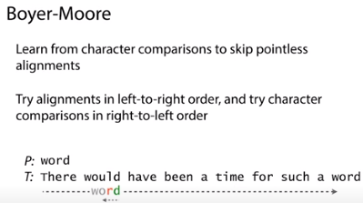

Slide 17
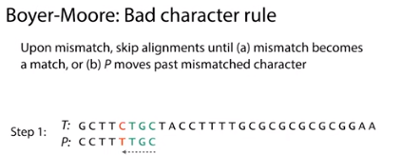

Slide 18
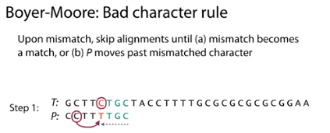

Slide 19
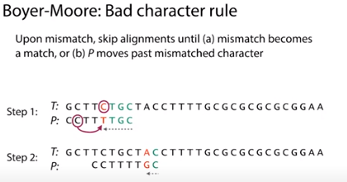

Slide 20
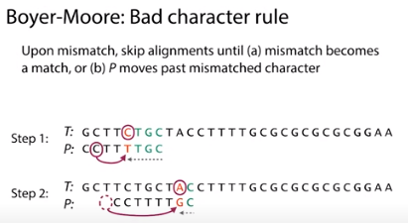

Slide 21
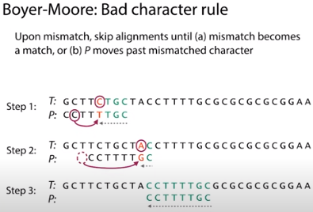

Slide 22
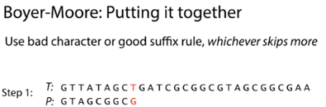

Slide 23
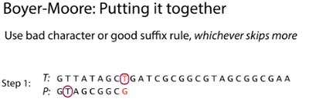

Slide 24
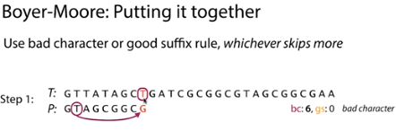

Slide 25
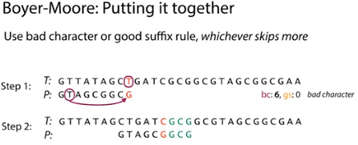

Slide 26
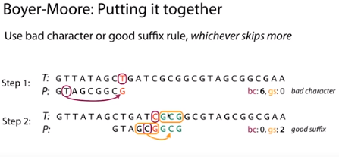

Slide 27
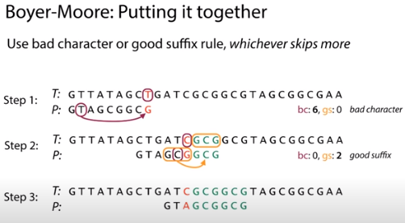

Slide 28
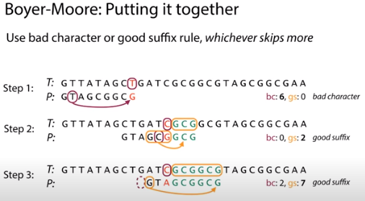

Slide 29
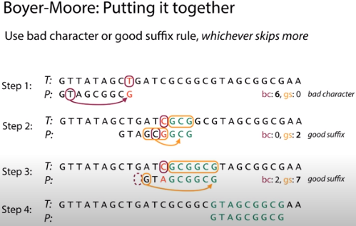

Slide 30
Pattern Matching Algorithms
Boyer-Moore Algorithm (contd.)
The following steps describe the basic Boyer-Moore algorithm at a high level:
Align the target and text on the left.
Repeat until the target’s last character is aligned beyond the end of the text:
Compare the characters in the target with the corresponding characters in the text, starting from the end of the target and moving backwards toward the beginning.
If all the characters match, you’ve found a match.
Suppose character X in the text doesn’t match the corresponding character in the target. Slide the target to the right until the X aligns with the next character with the same value X in the target to the left of the current position. If no such character X exists to the left of the position in the target, slide the target to the right by its full length.

Slide 31
Time Complexity
Worst-case performance Θ(m) preprocessing + O(mn) matching
Best-case performance Θ(m) preprocessing + Ω(n/m) matching
When the pattern does occur in the text, running time of the original algorithm is O(nm) in the worst case

Slide 32
Pattern Matching Algorithms
Knuth-Morris-Prat Algorithm
When the finite automata for a pattern P is constructed, it is easy to put in the arrows that correspond to a successful match
For Example: the first step to draw for the pattern P = AABC is given as shown in Figure below:
Start A A B C
Figure: State transition diagram that accepts AABC
The difficult part is to insert other arrows. The Knuth-Morris-Prat (KMP) algorithm constructs the flowchart that can be used to scan the text
1
2
3
4
*

Slide 33
Example
j | 0 | 1 | 2 | 3 | 4 | 5
P[j] | a | b | a | c | a | b
F(j) | 0 | 0 | 1 | 0 | 1 | 2

Slide 34
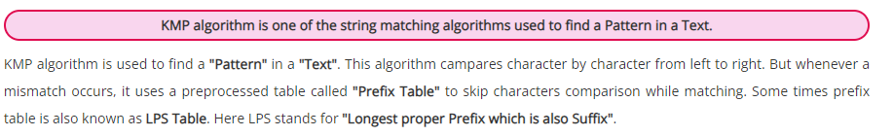
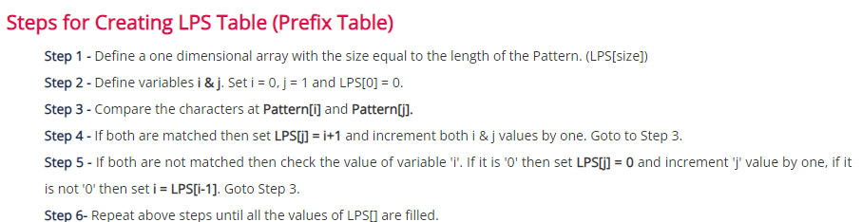
Knuth-Morris-Prat Algorithm

Slide 35
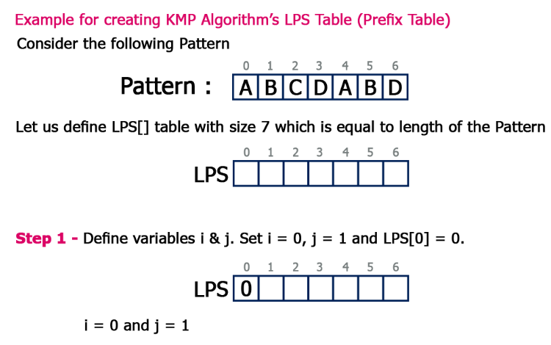
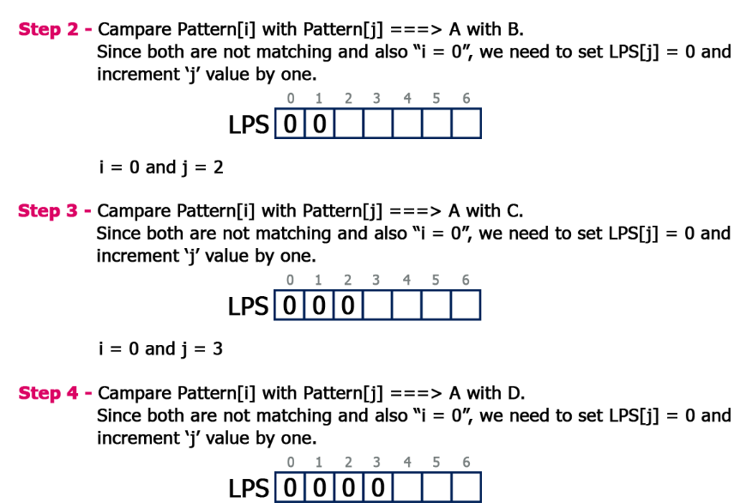
Knuth-Morris-Prat Algorithm

Slide 36
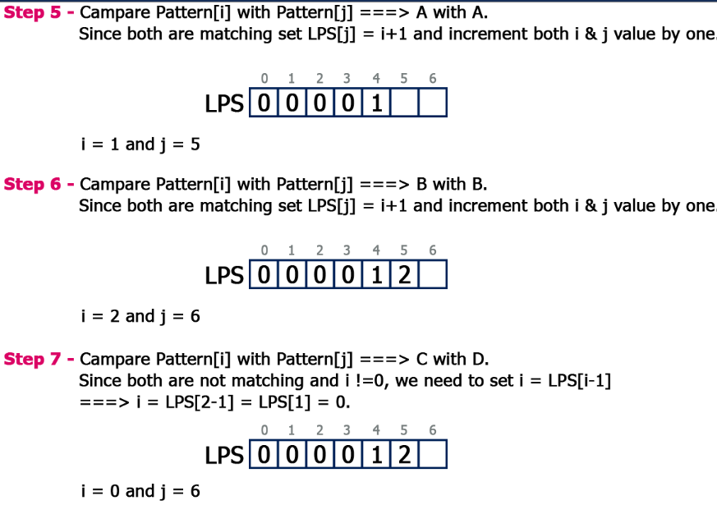
Knuth-Morris-Prat Algorithm

Slide 37
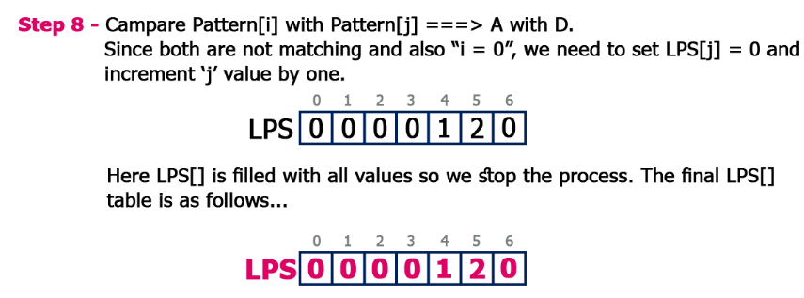
Knuth-Morris-Prat Algorithm

Slide 38
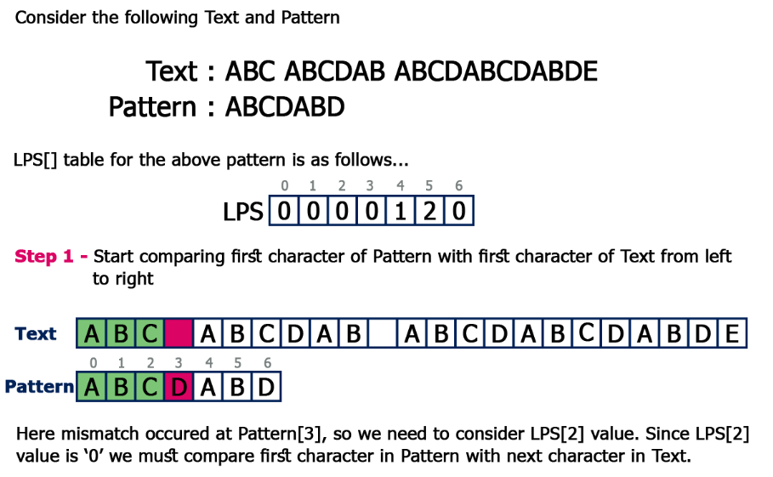
Knuth-Morris-Prat Algorithm

Slide 39
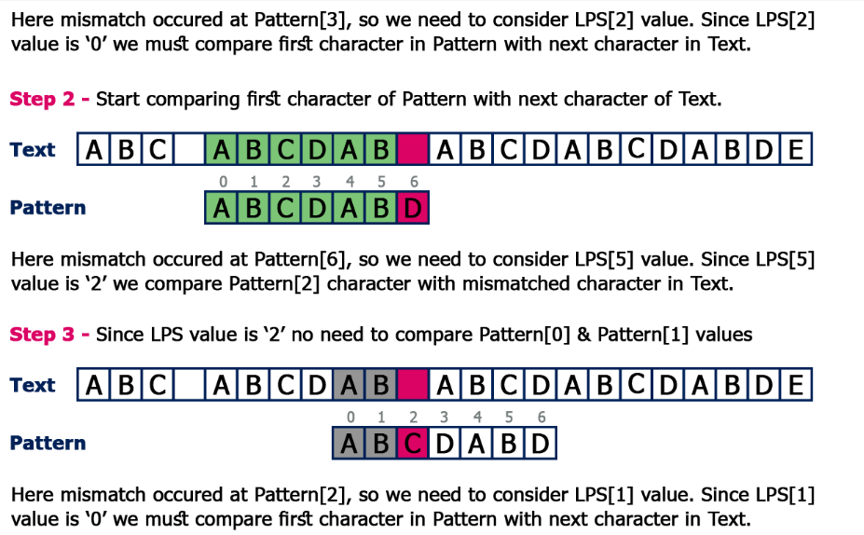
Knuth-Morris-Prat Algorithm

Slide 40
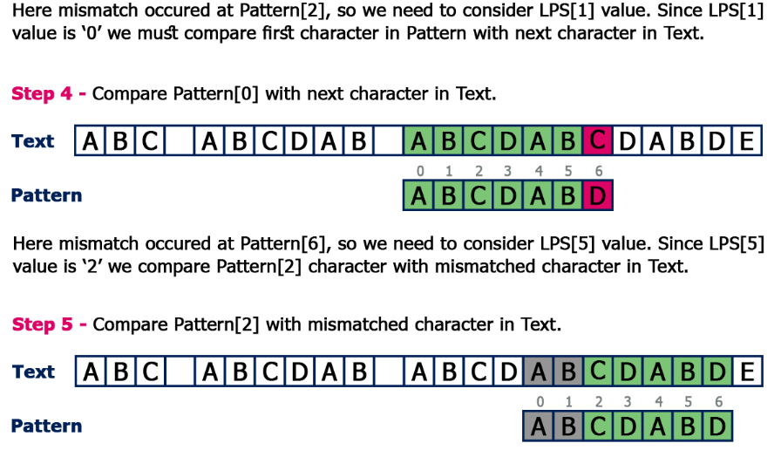
Knuth-Morris-Prat Algorithm

